Slide 1

HARVARD UNIVERSITY
Harvard University is a private Ivy League research university in Cambridge, Massachusetts, United States. Founded October 28, 1636, and it is the oldest institution of higher learning in the United States. Its influence, wealth, and rankings have made it one of the most prestigious universities in the world.
The department of Statistics ranked 3rd in the U.S. Founded in 1957, the deep interplay between application, computation, and theory is the cornerstone of our community, as well as the backbone of data science.

Slide 2

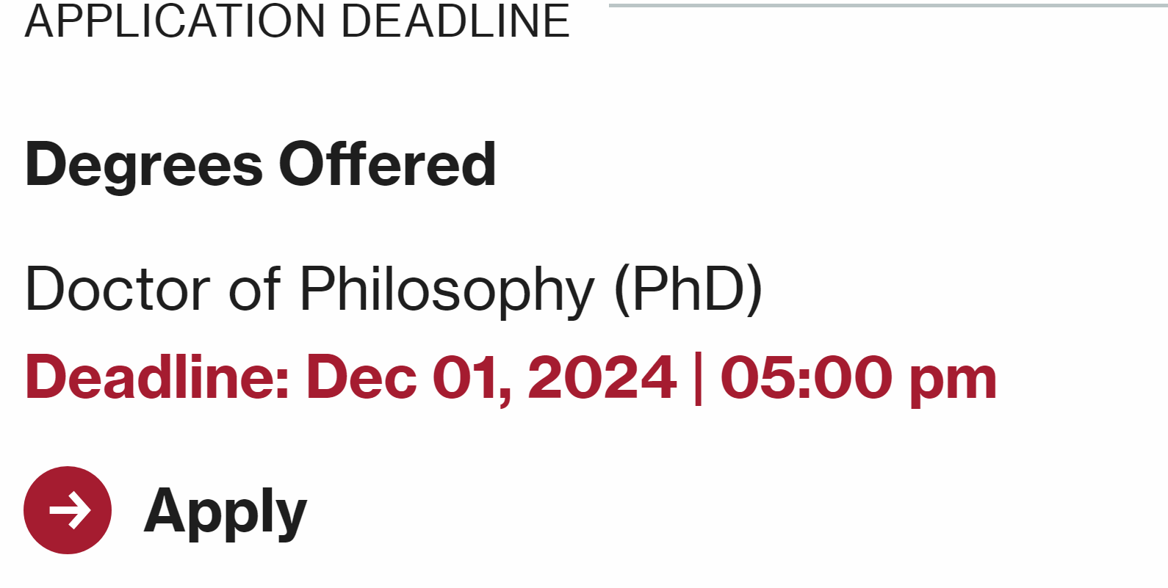

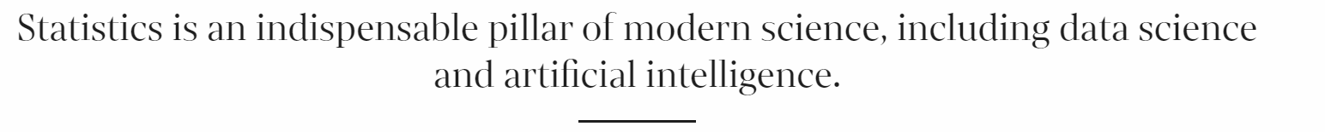
Department of Statistics
PHD in Statistics
MA in Statistics (not accept outer applications since 2017)
Admission decision will be made by Committee.

Slide 3
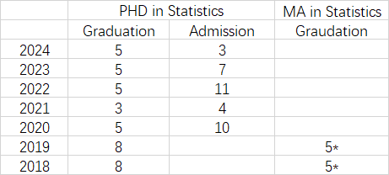

Admission Requirements Financial Aid
Graduation Data
Tuition Fee
First 2 years: Full Time, $55,656/ year
Financial Aid will cover all the tuitions and other expenses ($4500/month).
English Proficiency
Waive;
IELTS ≥ 6.5 / TOEFL(iBT) ≥ 80
Resume (Required)
Personal Statement: ≤ 500 words, Required.
Statement of Purpose: ≤ 1000 words, Required.
Standardized Tests:
GRE General (Optional)
GRE Subject: (Optional)
Academic Background:
Requirements: Linear Algebra, Advanced Calculus.
Measure Theory and Analysis will be helpful to the application.
Have the experience of statistical computational and simulation.
Recommend Letter:
3 Letters
Submit before Deadline.

Slide 4
PHD Program Timeline
Course Requirement:
PHD Qualification Test:
Theory Test: STAT210~213 Course, waive if all get A- or above. (G2 Spring Examination)
Applications: STAT305 course & presentation, or 30 min presentation before G3 spring.
Oral Presentation: 30 minutes G2 year
Quitted this program if any one of tests are not passed.
Post-Qualifying Talks (Research Presentation): Introducing the previous research and progress.
Dissertation: G3 year, submit the topic of essay to supervisor. & Abstract (1 page).
Dissertation Defence:
4 weeks ago: submit draft version. Start from G3
In G6 or higher, at least report the progress to supervisor yearly.
Application to PHD Degree: November, February, May
Source: https://gsas.harvard.edu/policy/statistics

Slide 5
Future Development
Faculty Position:
Stanford
Upenn
Berkeley
JHU
Carnegie Mellon University
Columbia University
GIT
…
Career Development:
Google
Apple
Etsy
Citedal
Boston Red Sox
…

